Slide 1
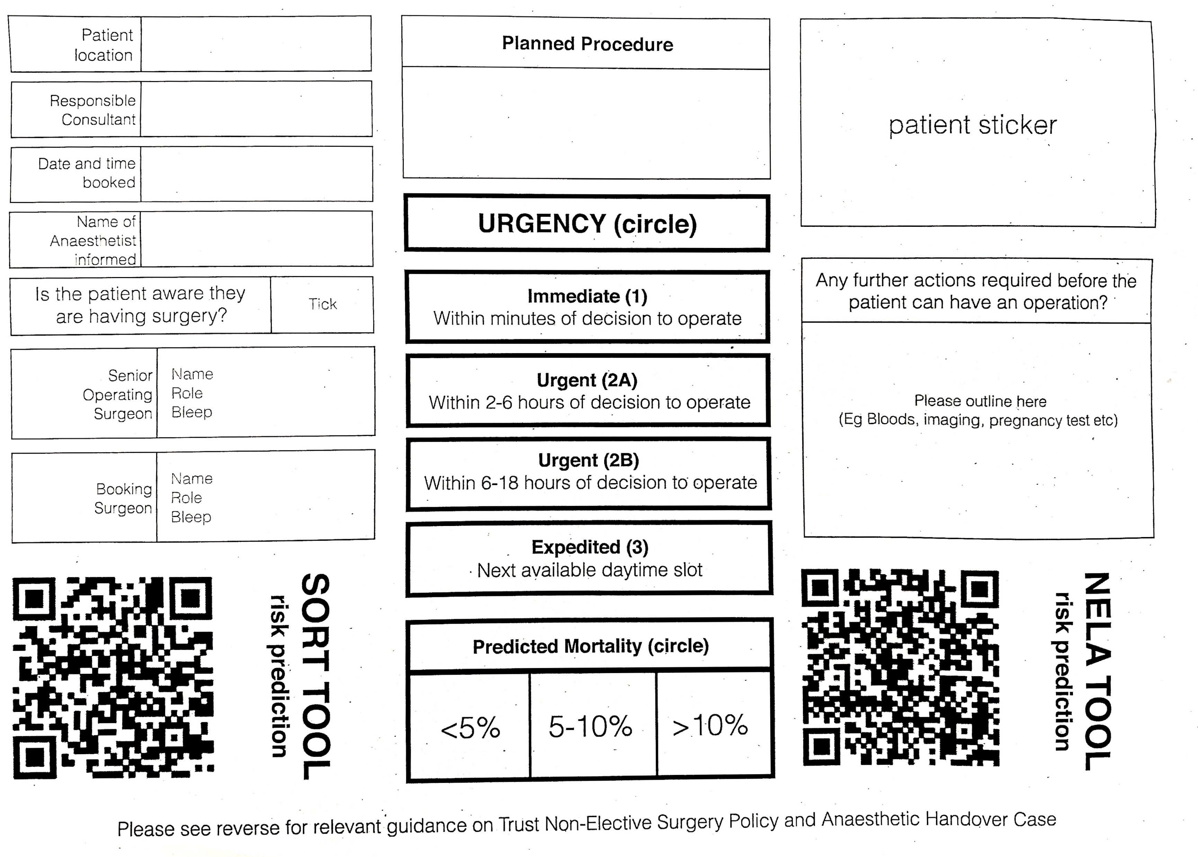
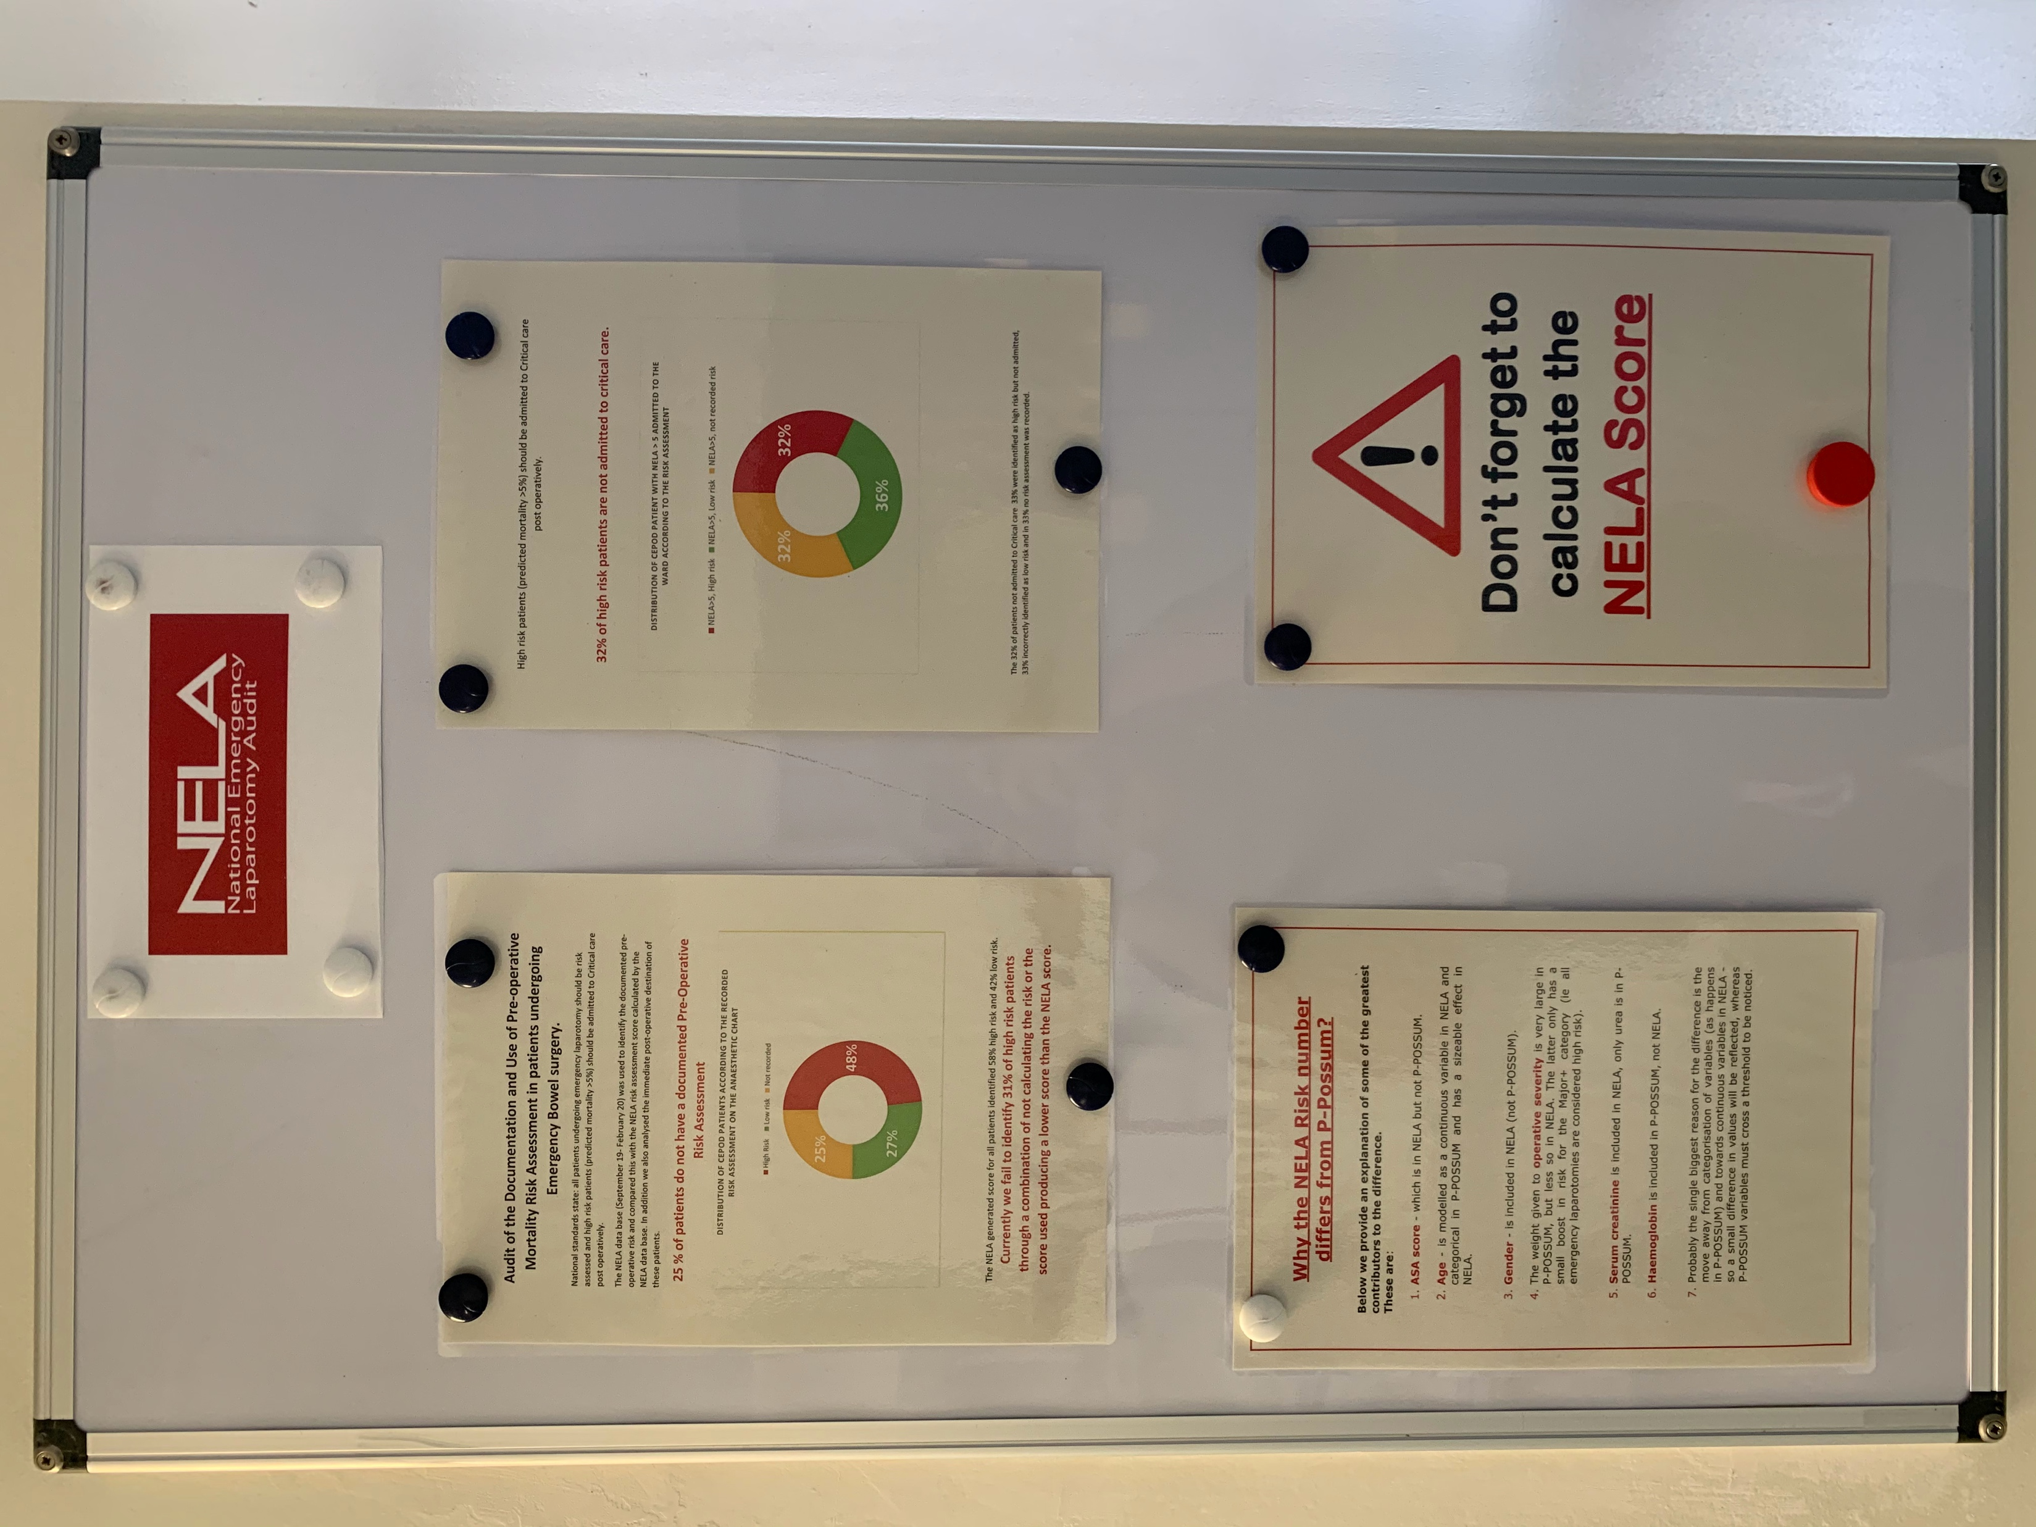
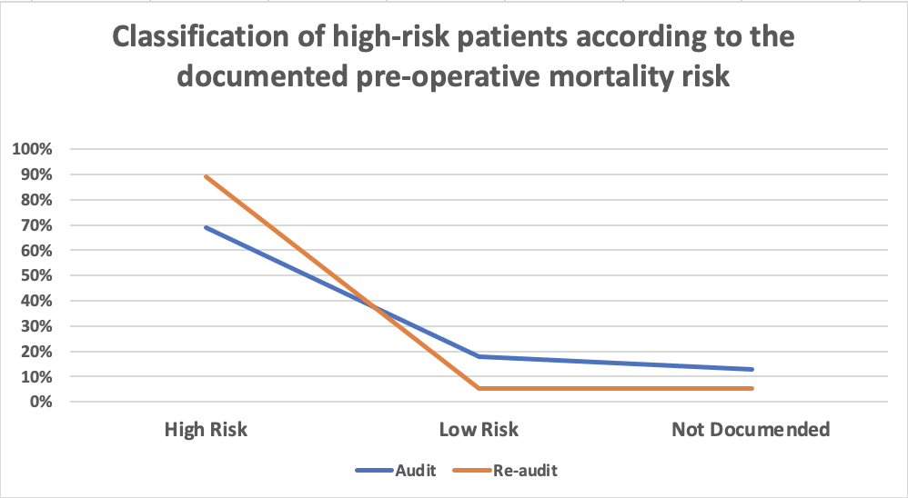
Using the NELA risk prediction tool to identify high-risk patients pre-operatively and plan the optimum postoperative care pathway during the multidisciplinary discussion: a complete audit cycle. Dr. Mina Saad ¹ and Dr. Andrew Claxton² ¹ Senior Clinical Fellow Anaesthesia ² Consultant Anaesthesia, The Royal Wolverhampton NHS Trust
Introduction
Pre-operative risk prediction should be calculated and recorded in all patients undergoing emergency bowel surgeries to ensure the correct identification of high-risk patients with mortality risk ≥ 5%, in order to follow the national standards of care including direct admission to the ICU postoperatively in order to improve the patient outcome [1]. This audit aims to assess the compliance and encourage all the anaesthetists and surgeons in the Royal Wolverhampton NHS trust to use the NELA risk calculator as a baseline for care planning.
Methods
Data collected over 5 months in 2019/2020 from 135 patients to examine the documentation of pre-operative mortality risk and correlate it with the NELA score generated by the NELA database and the same data was recollected in 2020/2021 from 85 patients after the introduction of some measures to promote the calculation of NELA score. These measures included a new emergency cases booking form mandating the calculation of mortality risk and including a QR code linked to the NELA risk prediction score (Figure 1), NELA information board (Figure 2) on which NELA reports are attached and a virtual departmental presentation on the importance of NELA calculation tool and its impact on planning the patient optimum care pathway.
Figure 1: New emergency cases booking form
Figure 2: NELA information board
Results
The correct pre-operative identification of high-risk patients improved from 69% in the audit to 89% in the re-audit, the percentage of high-risk patients wrongly estimated as low risk dropped from 18% to 5.5% and the percentage of not documented high risk patients dropped from 13% to 5.5% (Figure 3).
Figure 3:
Discussion
The data collected in the re-audit shows a positive deflection in the identification of high-risk patients according to the NELA guidance criteria. The effect on ICU admission couldn’t be correlated due to the second wave of the COVID pandemic.
References
[1] https://www.nela.org.uk/Standards-Documents#pt (last access 19/4/2021)

